Slide 1
PROTECTING OUR CHURCHES
Anna Chung, Esq. SECC General Counsel

Slide 2
MANDATED REPORTING & AB 506
AB 506
Section 18975 of the CA Business & Professions Code
Two Requirements
(1) Training for Mandated Reporters
(2) Live Scan Fingerprinted Background Check

Slide 3
#1 – TRAINING REQUIREMENT
Training Topics
Child Abuse & Neglect Identification
Child Abuse & Neglect Reporting
Who Needs this Training
Administrators
Employees
Regular Volunteers
Defined as a person who is at least 18 years old and has direct contact with or supervision of children for more than 16 hours a month or 32 hours a year.

Slide 4
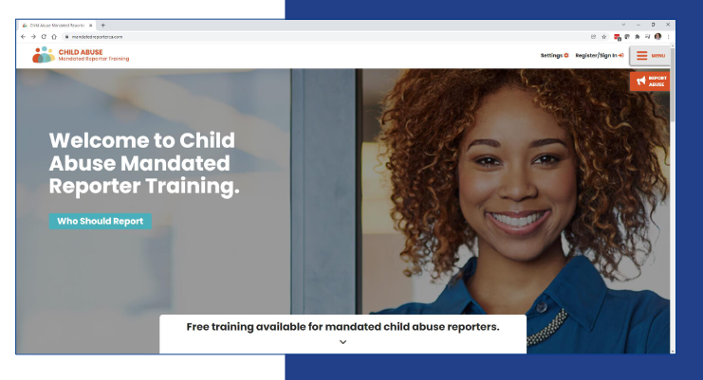
#1 – TRAINING REQUIREMENT
Where To Get the Training?
Https://mandatedreporterca.com
6 hours for clergy
4 hours for employees
2 hours for volunteers
How Often
Repeated and completed every two (2) years throughout the course of an individuals’ employment or volunteer engagement with SECC.

Slide 5
#1 – TRAINING REQUIREMENT
Commonly Asked Questions
Are certificates completed with another organization valid for volunteers at our church so they don’t have to re-take the training?
Do all employees, regardless of their interaction(s) with children, need to take the training?
Do all volunteers, regardless of their interaction(s) with children, need to take the training?

Slide 6
#1 – TRAINING REQUIREMENT
Commonly Asked Questions
No, all SECC employees and regular volunteers must take the training regardless.
Yes
No, only “regular volunteers” as it has been defined.

Slide 7
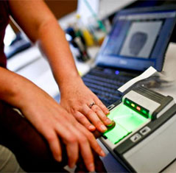
#2 – BACKGROUND CHECKS
Live Scan (Fingerprinted) Background Checks Required for:
Administrators (may include board members)
Employees
Regular Volunteers
Fees Involved
State Check (DOJ) - $32 for employees, waived for volunteers
Federal Check (FBI) - additional $17 for employees, $15 for volunteers
Subsequent Arrest Notice – waived for nonprofits
Fingerprint Rolling Fee (depends on Live Scan location) – Free to $99 (typically $20-30)

Slide 8
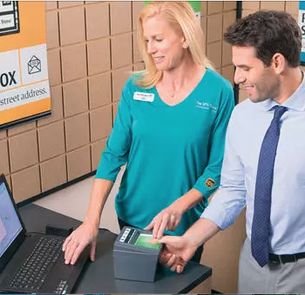
#2 – BACKGROUND CHECKS
Where can I go to get this completed
HR Department?
Live Scan locations
https://oag.ca.gov/fingerprints/locations
Deadline

Slide 9
#2 – BACKGROUND CHECKS
Commonly Asked Questions:
What if someone refuses to get a Background Check?
Can I volunteer if I don’t have a SS# and don’t want to undergo a Live Scan?
What about those have already had a prior background check via Live Scan?

Slide 10
#2 – BACKGROUND CHECKS
Answers:
We cannot continue to employ or engage the services of an individual who refuses to comply with the law.
Yes, but you cannot be a “regular volunteer” as defined, and there must be two other mandated reporters who have been scanned/trained in the room at all times if volunteering with children.
There is no exception under the statute for someone who had a prior background check done, even if LiveScan. One must do it again.

Slide 11
#3 – POLICIES & SUPERVISION
SECC Child Abuse & Sexual Misconduct Policy
Two Mandated Reporter Policy (“Two Adult Rule”)
To the greatest extent possible, the presence of at least two mandated reporters, who have been screened and trained and are not related to each other, whenever ministry activities involve contact with or supervising children.
California does not consider volunteers to be mandated reporters.
Consequences of Non-Compliance
Violation of the law (civil and criminal penalties)
Jeopardizes child safety
Inability to lease or use 3rd party facilities who require compliance with AB 506

Slide 12
Resources/References
Adventist Risk Management – Safety Resources Newsletter and Presentations
ChurchWest Mandated Reporting
Church HR Network
https://adventistrisk.org/en-US/Safety-Resources/Solutions-NewsLetter/2023/February/NADENG-How-to-Protect-Your-Organization-from-a-Non?mc_cid=88d2fde9ea&mc_eid=ad482cbf20
https://adventistrisk.org/en-US/Safety-Resources/Solutions-NewsLetter/2023/January/NADENG-Managing-Known-Sex-Offenders?mc_cid=88d2fde9ea&mc_eid=ad482cbf20
https://churchwest.com/new-law-changes-on-how-we-implement-ab506/

Slide 13
Questions?
Anna Chung, Esq., General Counsel
Southeastern California Conference
11330 Pierce St.
Riverside, CA 92505-3303
(951) 509-2230 Telephone
anna.chung@seccsda.org

